Slide 1
Industry Group Performances

Slide 2
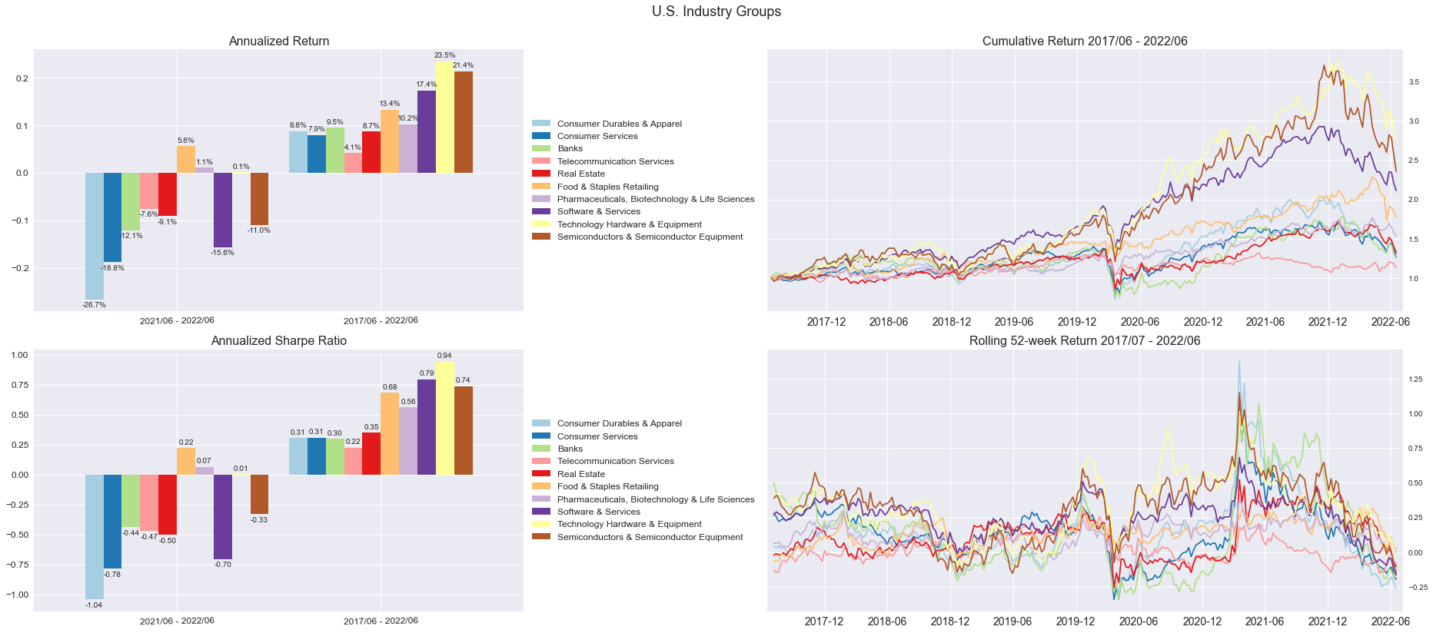
U.S. Industry Groups Return (Top 5 and Bottom 5 Sharpe Ratio)
Stock universe: S&P Composite 1500
Weighting Scheme: Value-weighted (No weightings cap)

Slide 3
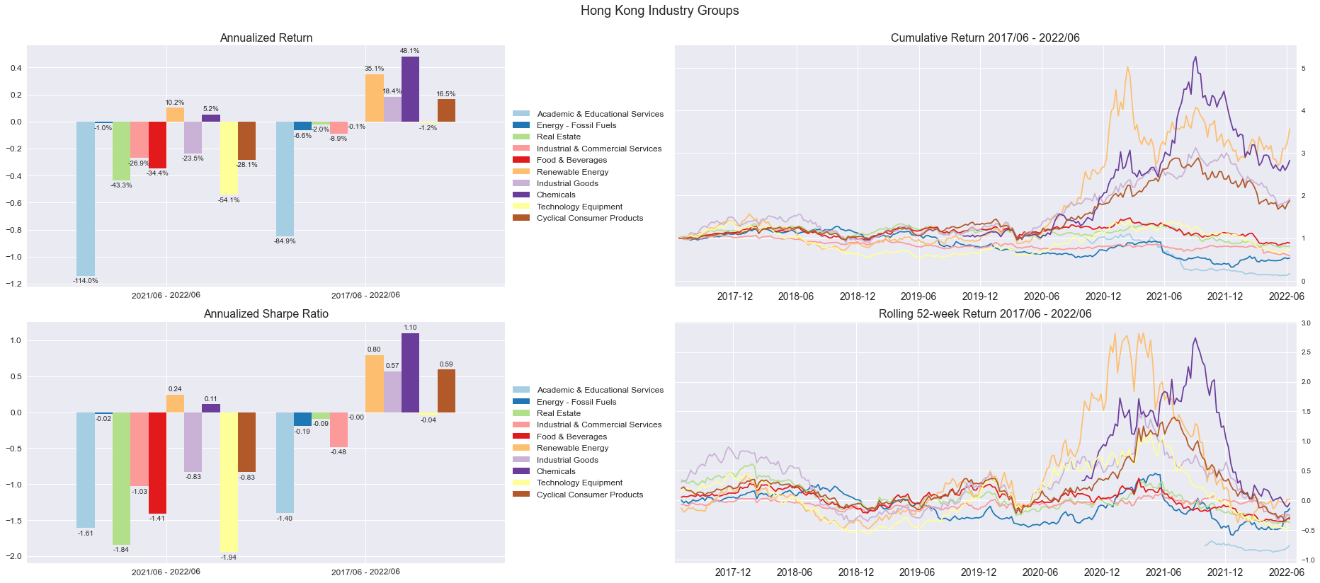
Hong Kong Industry Groups Return (Top 5 and Bottom 5 Sharpe Ratio)
Stock universe: Hong Kong Listed Stock Top 500
Weighting Scheme: Value-weighted (No weightings cap)

Slide 4
Sector Rotation Performances (Industry Group)

Slide 5
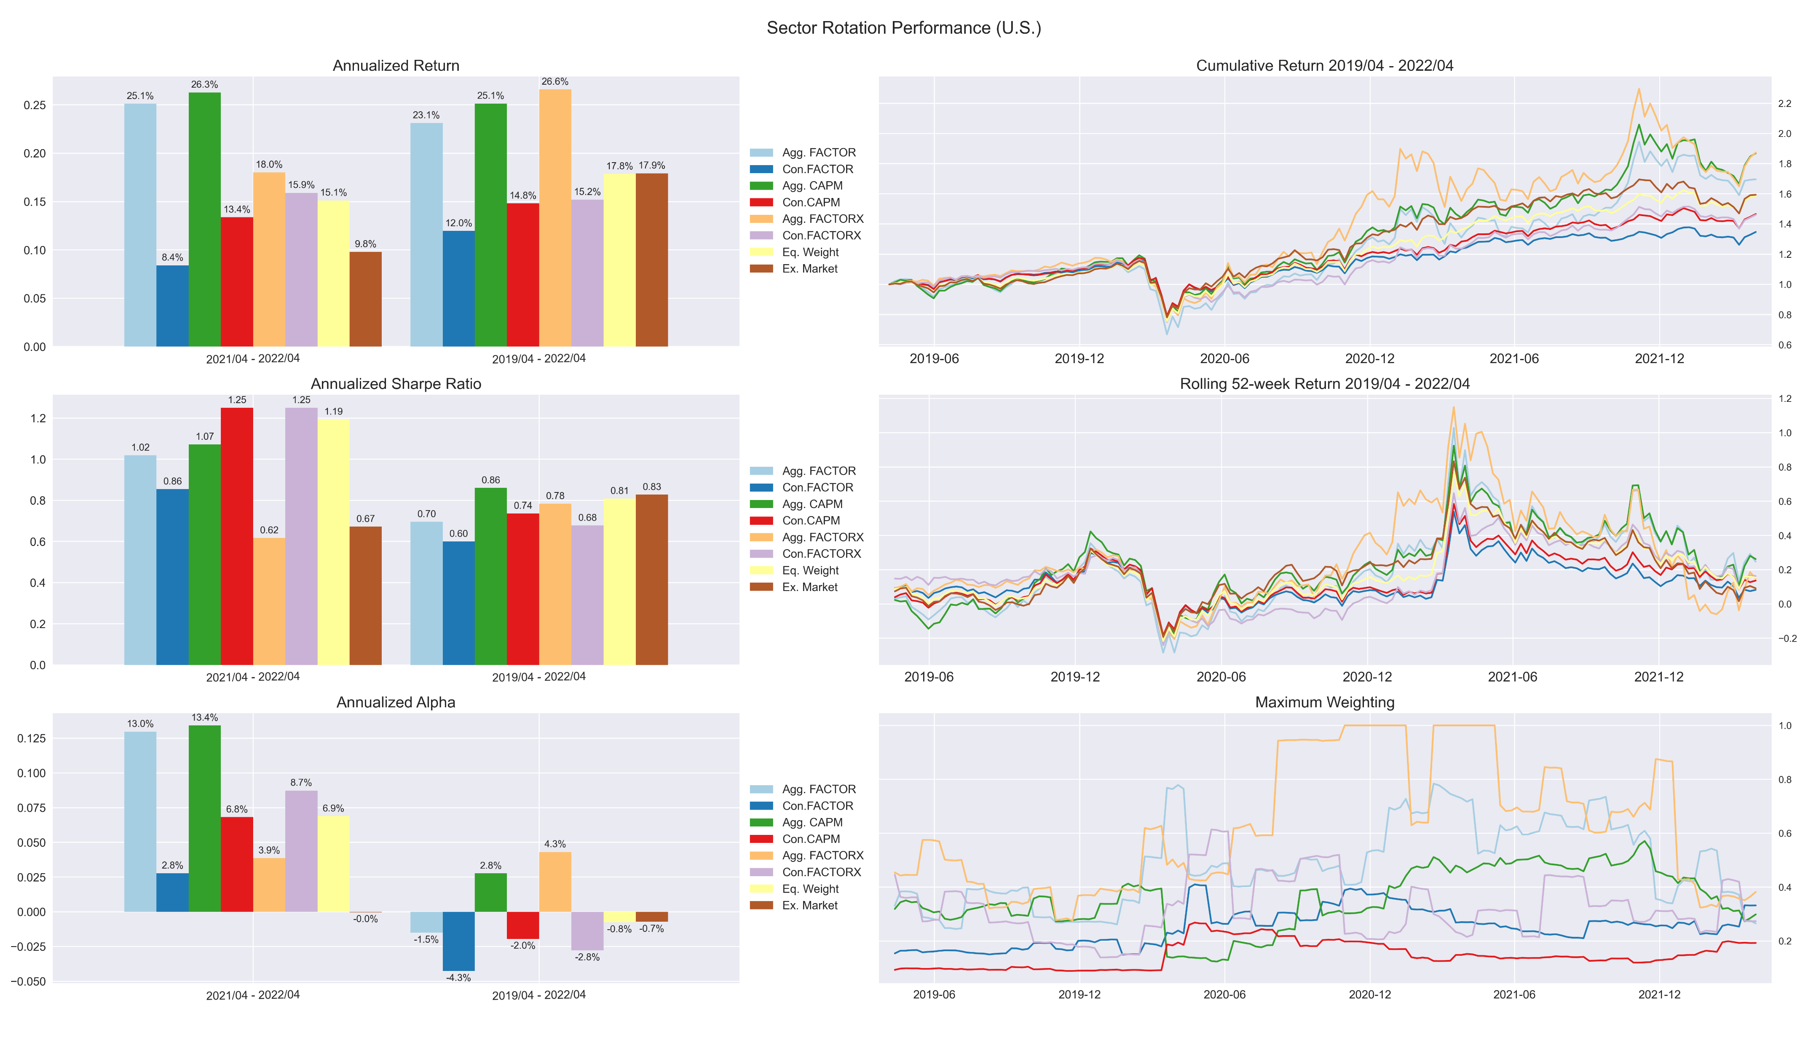
U.S. Portfolio Performances – 5Y

Slide 8
Sector Rotation Performances (Sector)

Slide 9
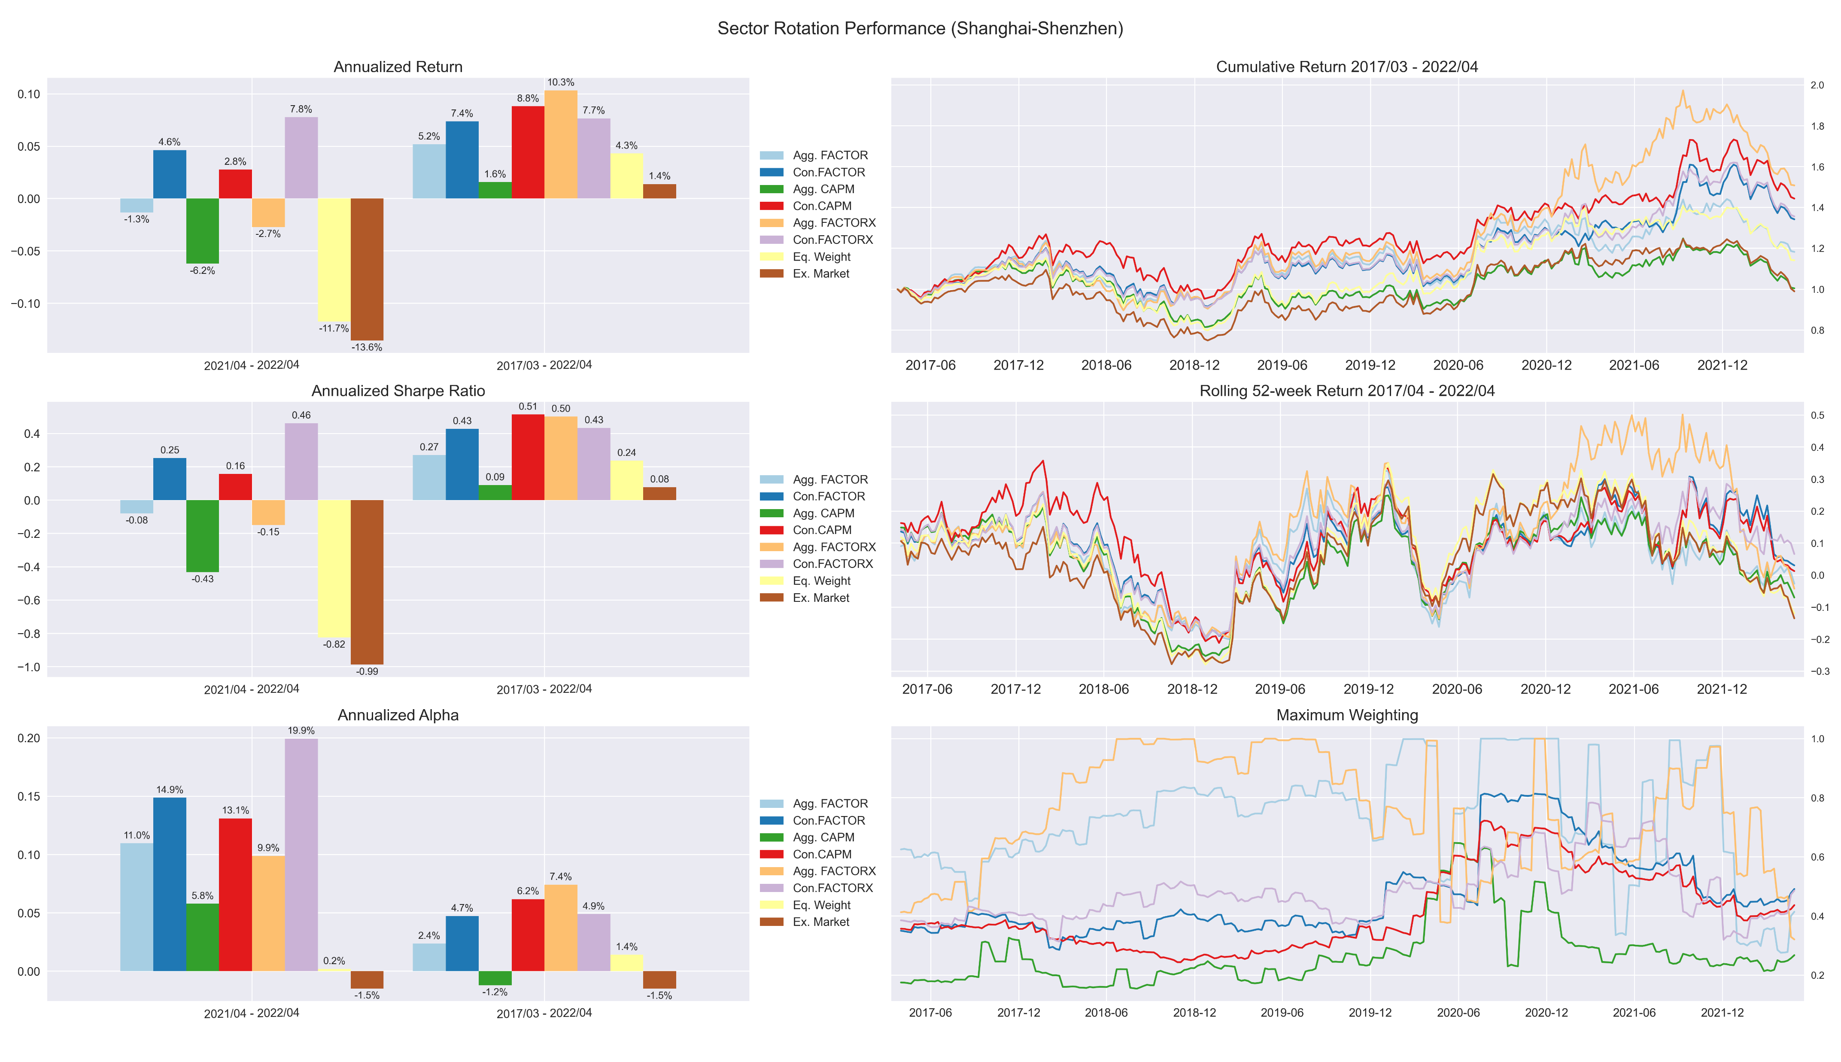
Shanghai-Shenzhen – 5Y

Slide 10
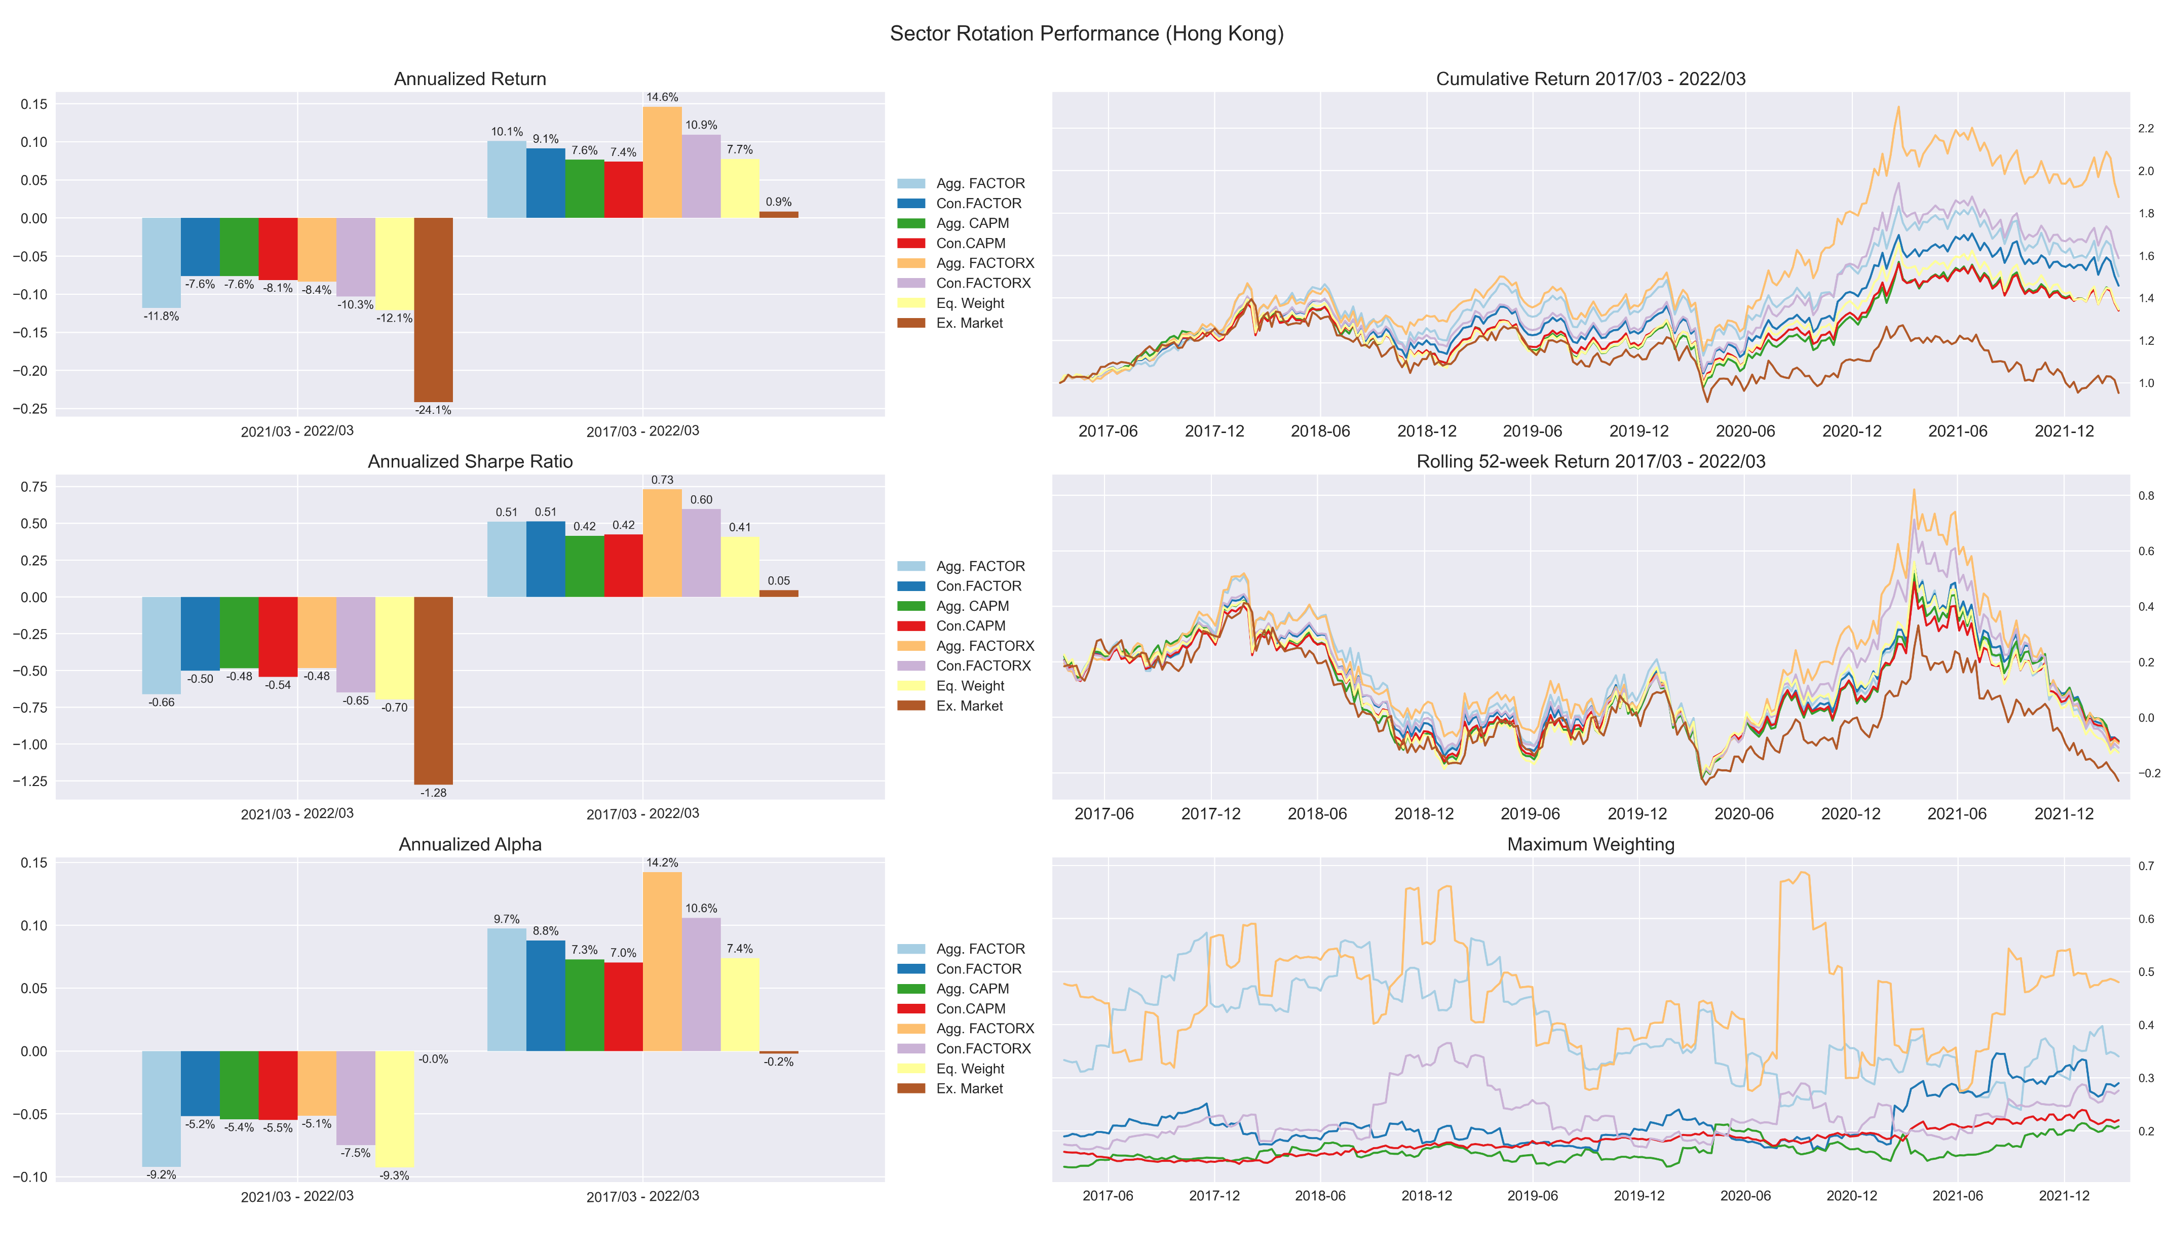
Hong Kong – 5Y

Slide 11
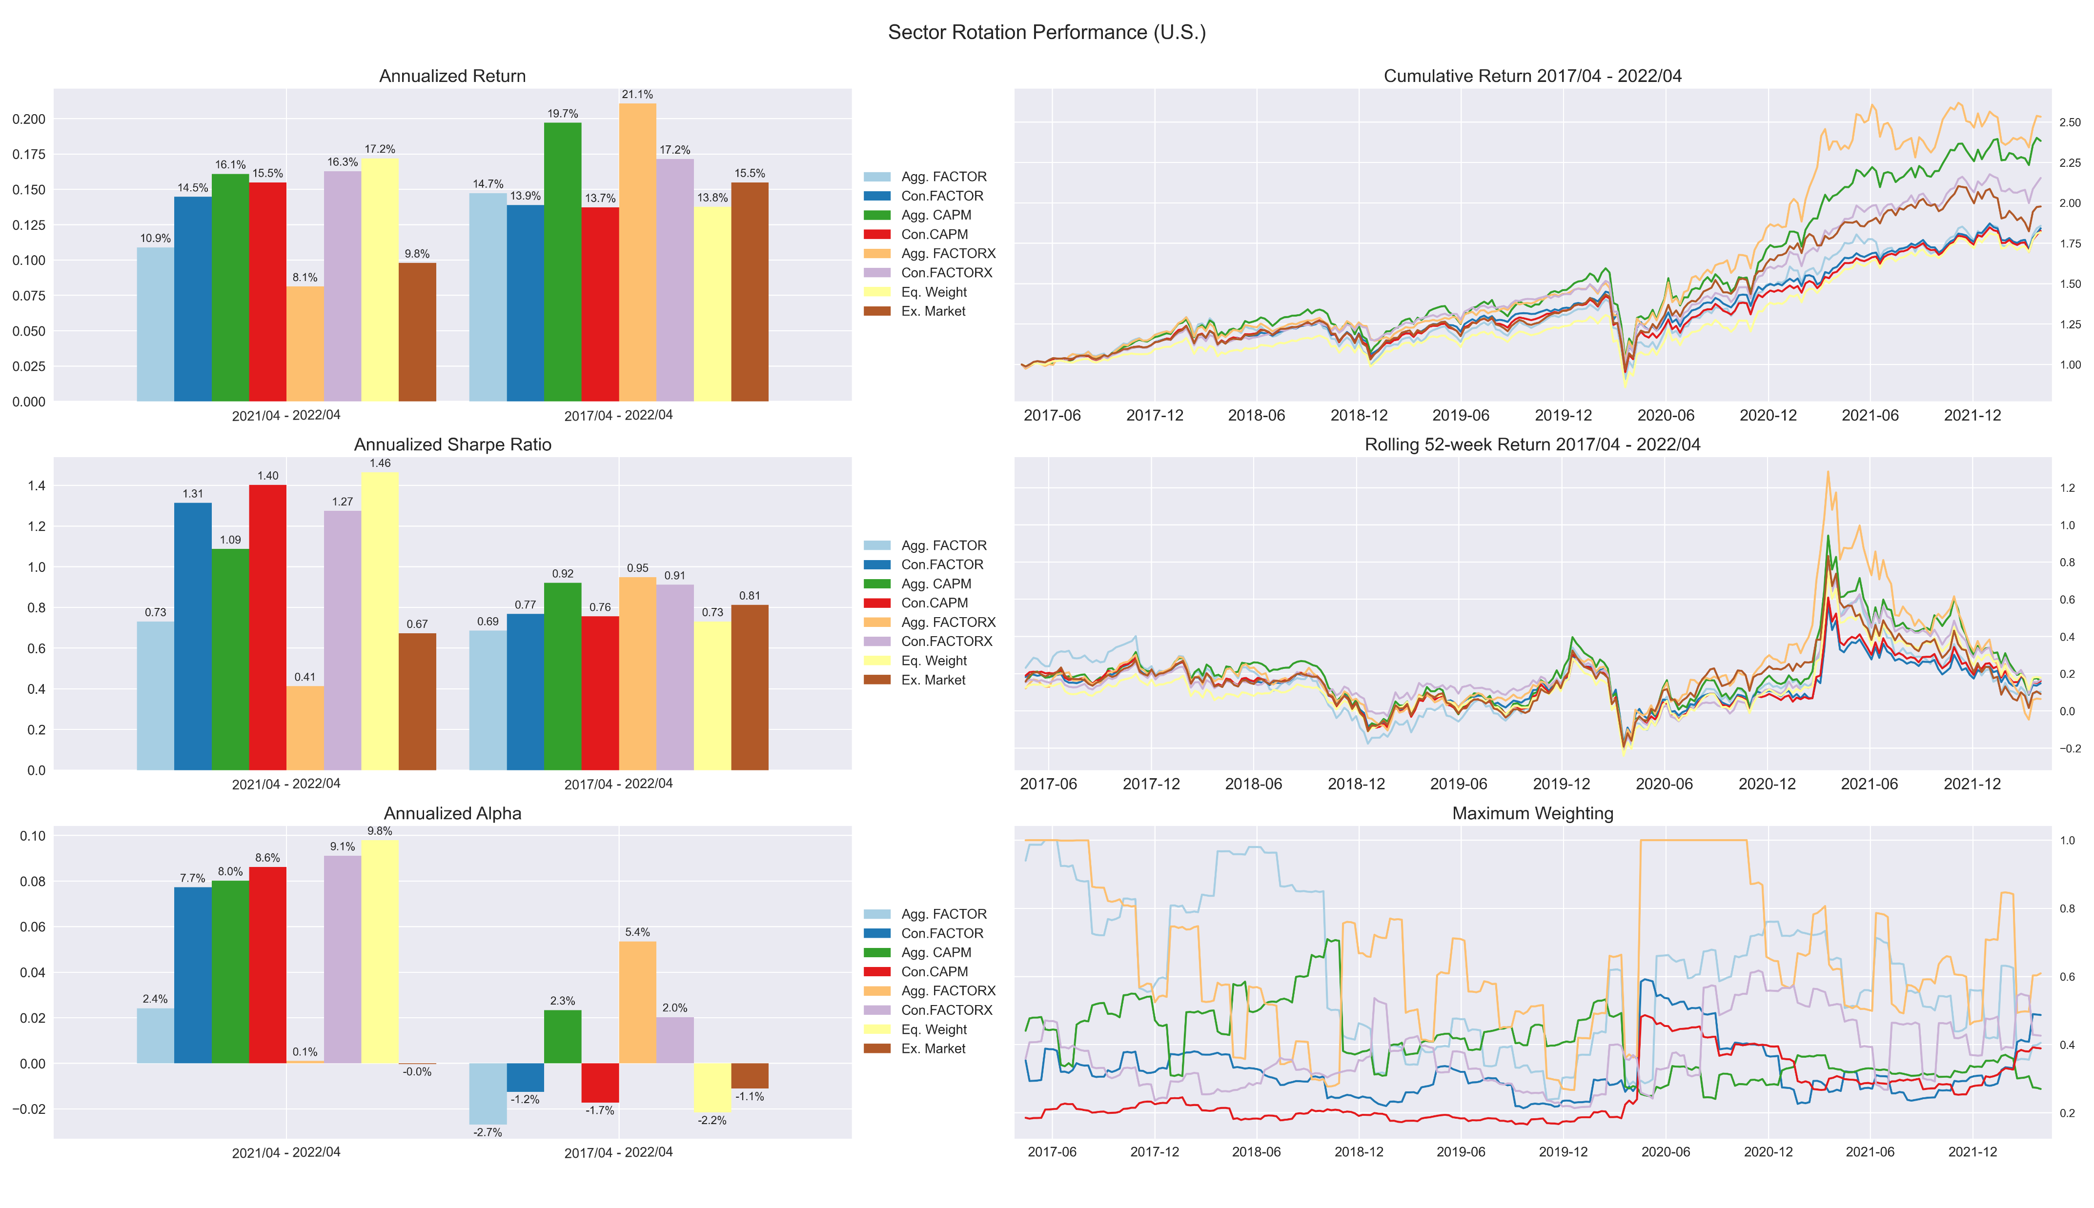
U.S. – 5Y

Slide 12
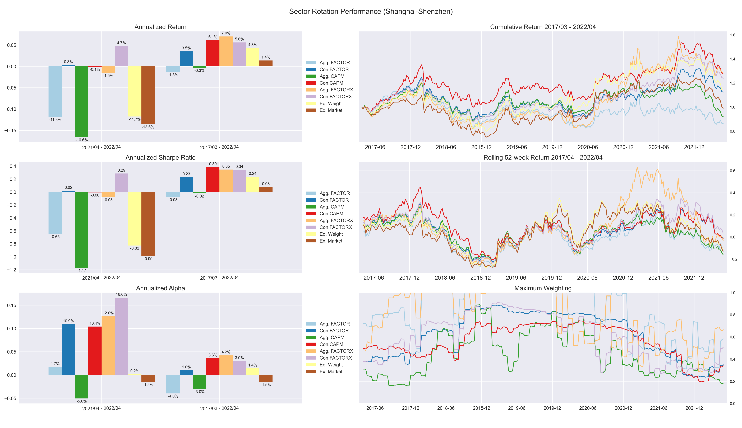
Shanghai-Shenzhen – 3Y

Slide 13
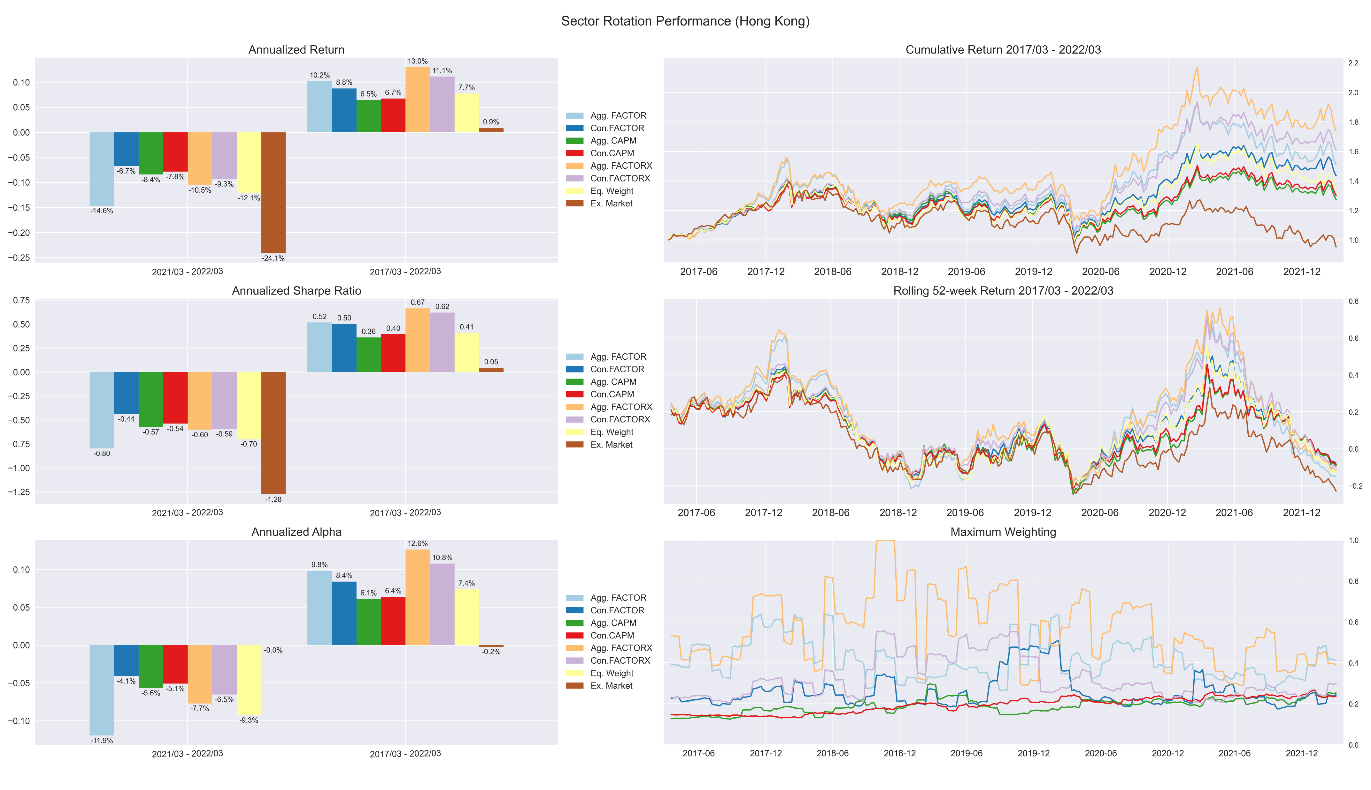
Hong Kong – 3Y

Slide 14
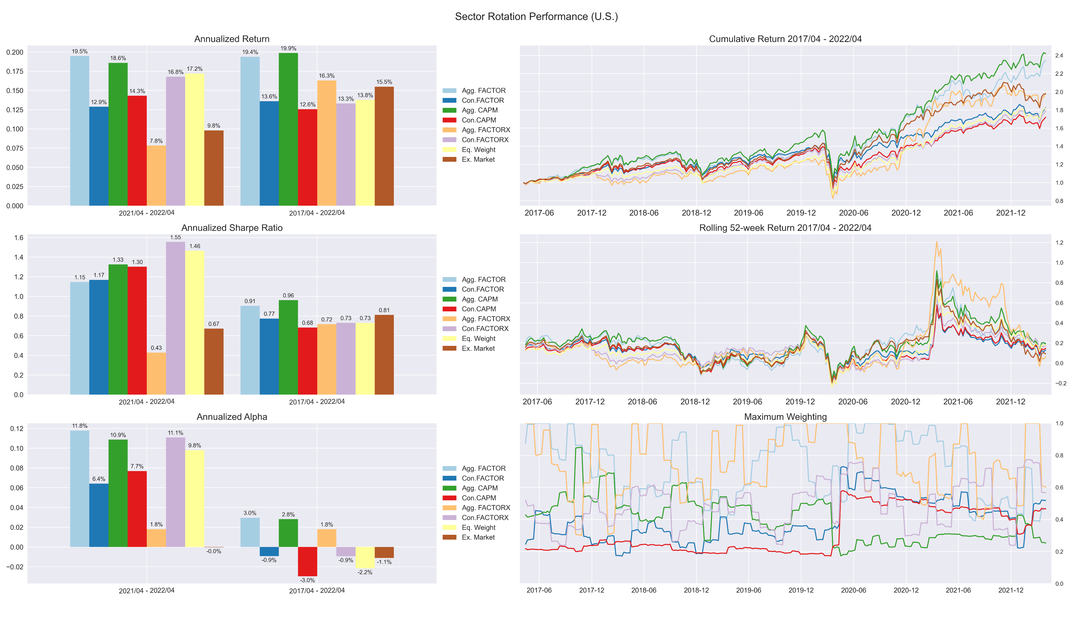
U.S. – 3Y

